Slide 1

CS 410 – rjena2@illinois.edu
Hot Stock Pick

Slide 2
Overview
This will help to gather the stock market data from various sources and recommend and help users to decide whether it is a good time to buy his favorite stock or not.

Slide 3
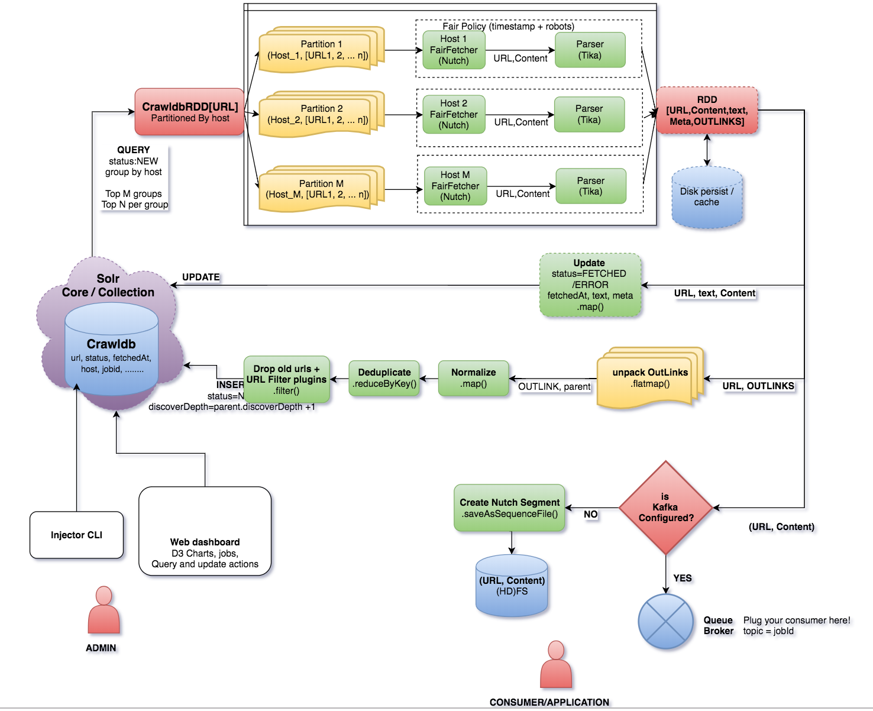

Slide 4
Implementation:
This project has been implemented based on the Sparkler. Sparkler is a tool, which can crawl the website using the advanced distributed computing technologies.
Pre-requisite:
1) Java 1.8
2) Sparkler
3) Apache Solr

Slide 5
Advantage
1) Its based on distributed computing technologies.
2) Its highly scalable.
3) Runs with high performance.
4) It provides fault tolerance.
5) It Supports complex and real-time analytics.
6) Streams out the content in real-time
7) Java Script Rendering
8) It’s a distributed crawler that can scale horizontally.
9) Easy to deploy and easy to use
10) ML based analysis
11) It provides real-time progress reports
12) It supports Batch crawling
13) It used Apache Solr as crawl database, so we can utilize the
rich search features of solr.
14) It Stream crawled content through Apache Kafka.

Slide 6
Installation
Java 1.8
Download and install java 1.8, if not already is there.

Slide 7
Sparkler:
Download and build from git repository.
1) Create a directory in your system, named sparkler.
mkdir ~/sparkler
cd sparkler
2) Download and unzip the zip file for sparkler or clone and checkout the below repository.
https://github.com/USCDataScience/sparkler
3) Once source code are in your local system, go to the sparkler directory. You should see below directories under it.
ls -ltr
sparkler-plugins
sparkler-deployment
scalastyle_config.xml
pom.xml
eclipse-codeformat.xml
docs
conf
bin
Release-Checklist.md
README.md
LICENSE
sparkler-tests-base
sparkler-api
sparkler-app
sparkler-ui

Slide 8
4) Make the build.
(Prerequisite is latest maven has been installed in your system. To check, install and run maven pls. refer the page:
https://maven.apache.org/)
mvn clean package
5) Build the dashboard UI for sparkler.
cd sparkler-ui
mvn clean package
6) Go to the parent sparkler directory and download apache solr.
cd ~/sparkler
# Download Solr Binary
For Mac : curl -O http://archive.apache.org/dist/lucene/solr/7.5.0/solr-7.5.0.tgz
For other: wget "http://archive.apache.org/dist/lucene/solr/7.5.0/solr-7.5.0.tgz" # or pick your version and mirror
7) Extract Solr
tar xvzf solr-7.5.0.tgz
8) Add crawldb config sets
cd solr-7.5.0/
cp -rv ~/sparkler/build/conf/solr/crawldb server/solr/configsets/
9) Setup the sparkler dashboard.
cp -r ~/sparkler/sparkler-ui/target/sparkler-ui-*.war ~/sparkler/solr-7.5.0/server/solr-webapp/sparkler
cp ~/sparkler/build/conf/solr/sparkler-jetty-context.xml ~/sparkler/solr-7.5.0/server/contexts/

Slide 9
10) Start solr in cloud mode
bin/solr -e cloud
- select 1 node only for testing or choose the number of nodes as you like.
- choose default port 8983 for the node, else choose your own port. For multiple nodes, choose different ports as you like.
- give the new collection name as "crawldb"
- choose the default options for shards and replicas by entering enter.
- for configuration, type "crawldb" and enter.
The solr should start, running the zookeeper at localhost:9983, and collection crawldb.
11) check solr is running and sparkler dashboard is running.
open the pages in separate browser windows:
http://localhost:8983/solr
http://localhost:8983/banana/
11) Create a file to seed the URLs
crate a file "seedfile.txt", and put the URL's you want to crawl.
eg. add the below lines, to the seedfile.txt.
https://seekingalpha.com/
https://stocktwits.com/
https://finance.yahoo.com/
12) Inject Seed URLs
java -jar sparkler-app-0.*-SNAPSHOT.jar inject -sf seedfile.txt
or
bin/sparkler.sh inject -id sparkler-job-123456 \
-su https://seekingalpha.com/ -su https://stocktwits.com/ -su https://finance.yahoo.com/
13) run crawl.
bin/sparkler.sh crawl -id sparkler-job-123456 -m local[*] -i 10
Once finished, we are done with crawl the web and out crawldb database is ready to be used.
The documents are already indexed and clustered.

Slide 10
14) We can find the details of our crawling results from both solr ui and babnana dashboard.
http://localhost:8983/solr
http://localhost:8983/banana/
15) Search the solr index, from its REST interface as per your requirement to get the meaningful analysis and information.

Slide 11
e.g.
http://localhost:8983/solr/#/crawldb/analysis
http://localhost:8983/solr/#/crawldb/documents
http://localhost:8983/solr/#/crawldb/query

Slide 12
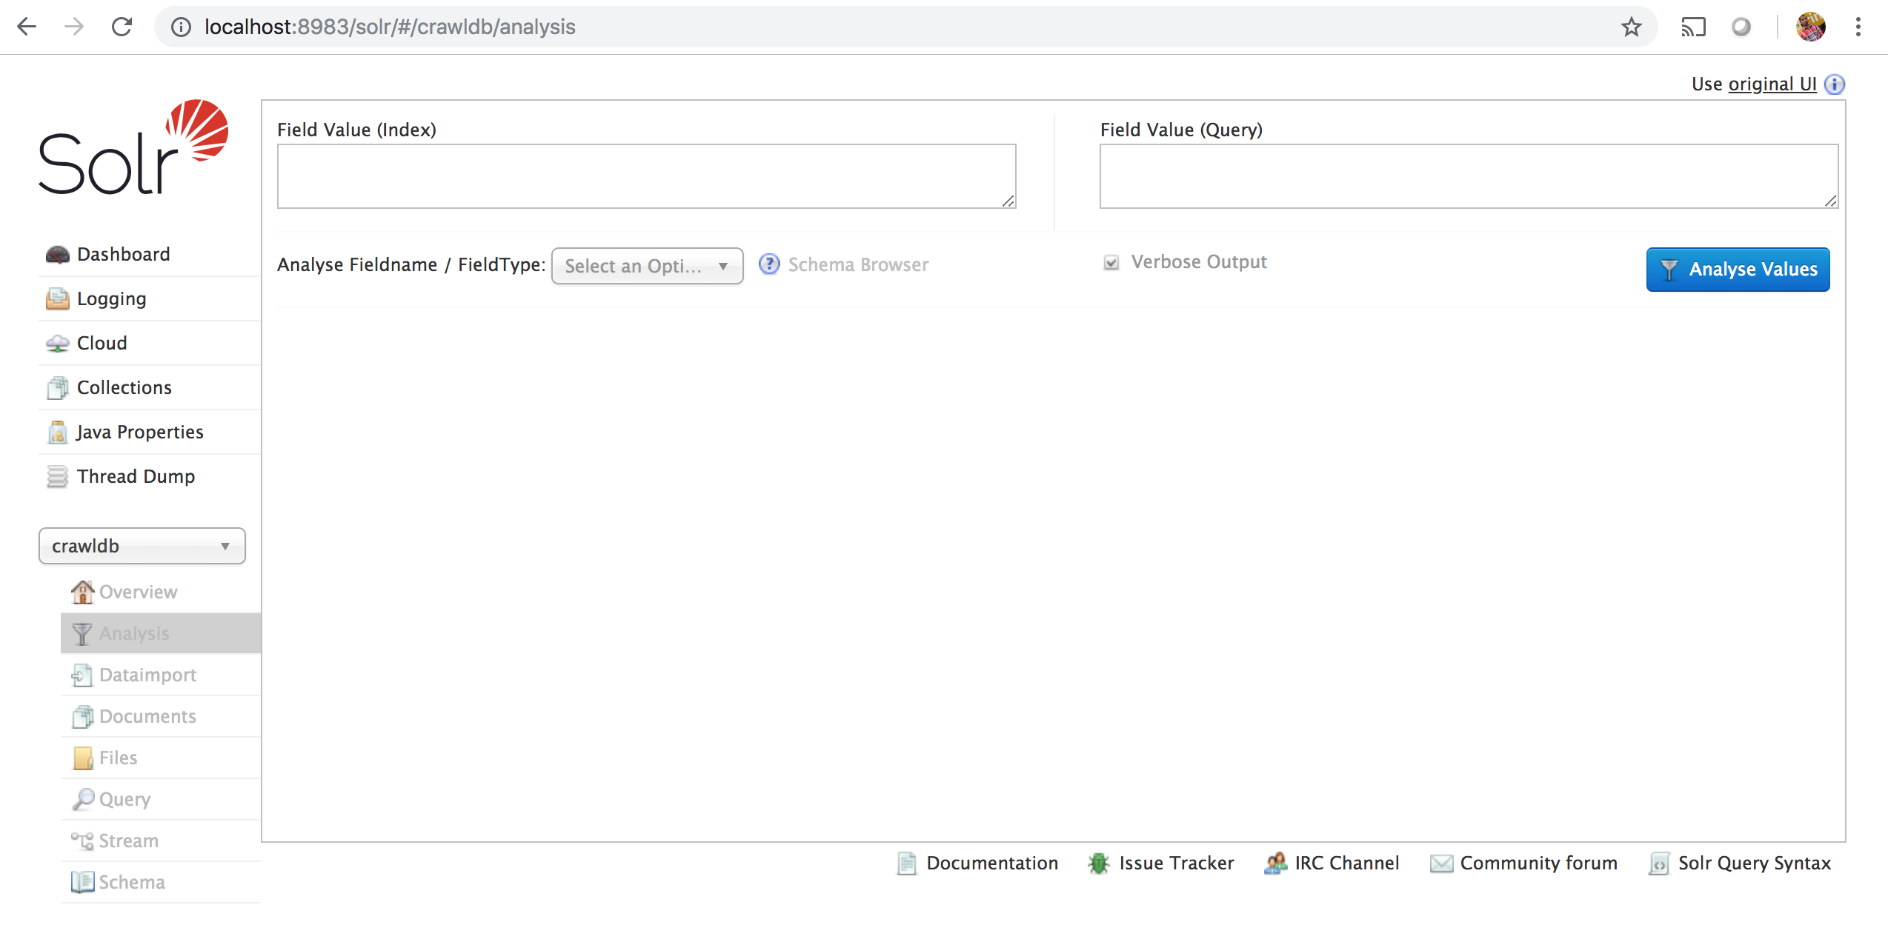

Slide 13
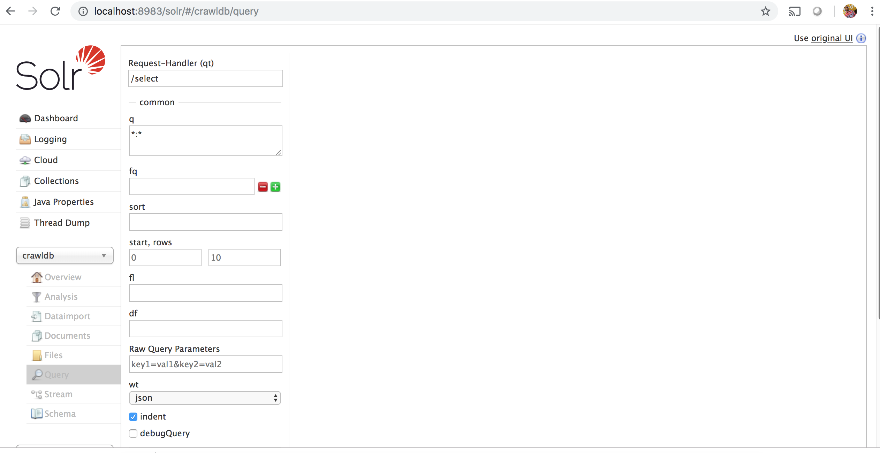

Slide 14
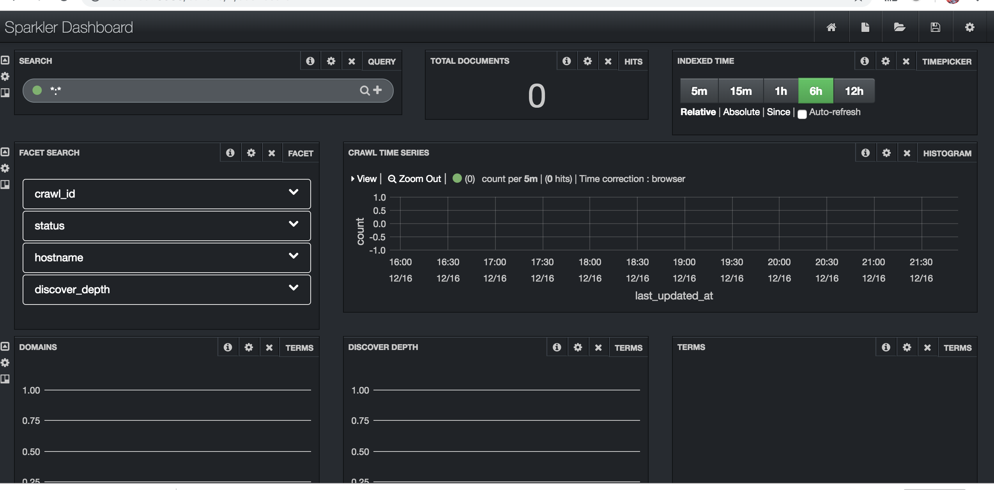

Slide 15
Future work
We need to implement and integrate Kafka, with the tool. By this we will get real time stock market data to flow to our system.
And we can get real time picture of our intrest data, and take a decision at that point of time.

Slide 16
References
https://github.com/USCDataScience/sparkler
https://spark.apache.org/
http://nutch.apache.org/
https://tika.apache.org/
http://lucene.apache.org/
http://lucene.apache.org/solr/
https://maven.apache.org/

